Slide 1
Debate and Discussion
Understanding the Differences and Importance

Slide 2
Introduction
Debate: A formal contest of argument where opposing sides present views.
Discussion: An exchange of ideas to reach understanding or solutions.
A debate is a formal, structured contest between opposing sides, aiming to win an argument by persuading others with evidence and reasoning. In contrast, a discussion is a more informal and collaborative exchange of knowledge, ideas, and opinions, focused on achieving a mutual understanding and increasing clarity about a topic, rather than convincing others of a specific viewpoint.

Slide 3
Objectives
Debate: Persuade the audience, defend or oppose a motion, showcase reasoning and speaking skills.
Discussion: Share perspectives, build knowledge collectively, reach conclusions or decisions.

Slide 4
Key Features of Debate
Structured and time-bound
Clear sides: For & Against
Competitive in nature
Judges or audience decide outcome

Slide 5
Key Features of Discussion
Open exchange of ideas
Collaborative, not competitive
No strict rules or time limits
Aims at problem-solving or understanding

Slide 6
Key Differences
Goal:
Debate: To win the argument and persuade the audience or opponents.
Discussion: To explore a topic, share perspectives, and gain deeper understanding collectively.
Structure & Format:
Debate: Highly structured, with agreed-upon rules and defined roles for participants.
Discussion: More informal and open, allowing for spontaneous contributions.

Slide 7
Key Differences
Approach:
Debate: Involves adversarial stances, arguing for and against a specific topic.
Discussion: Collaborative and open-ended, with participants contributing to a broader pool of ideas.
Outcome:
Debate: Success is measured by convincing others of a particular position.
Discussion: Success is seen in increased knowledge and greater understanding, even if viewpoints don't change.

Slide 8
Debate vs Discussion (Comparison)
Nature: Debate – Competitive | Discussion – Collaborative
Purpose: Debate – Win an argument | Discussion – Share & learn
Participants: Debate – Opponents | Discussion – Group members
Outcome: Debate – Decision/judgment | Discussion – Understanding/solution
Rules: Debate – Formal, structured | Discussion – Informal, flexible

Slide 9
Importance
Debate: Develops critical thinking, public speaking, persuasion skills.
Discussion: Improves teamwork, cooperation, and decision-making.
Debates and discussions are crucial for enhancing critical thinking, communication skills, self-confidence, and teamwork. They foster a broader knowledge base, allow for the exploration of diverse perspectives, and help develop persuasive arguments and strong leadership skills. Participating in debates also improves public speaking abilities, encourages logical thinking, and provides a healthy way to resolve conflicts by examining different viewpoints.

Slide 10
Key Benefits:
Enhanced Critical Thinking and Reasoning:
Debates force participants to analyze information, identify weaknesses in arguments, and think on their feet.
Improved Communication Skills:
Participants learn to articulate their thoughts clearly, structure arguments logically, and use persuasive language effectively.
Increased Confidence and Self-Esteem:
Presenting ideas in front of an audience builds confidence and helps develop independent and innovative thinking.
Broader Knowledge and Perspective:
Debates expose individuals to different subjects and viewpoints, expanding their understanding of current affairs and complex issues.

Slide 11
Key Benefits:
Development of Collaboration and Teamwork:
Working in groups to develop and present arguments strengthens teamwork and collaboration skills.
Better Listening Skills:
Active listening is essential to understand opposing viewpoints and formulate effective rebuttals, which is a core aspect of debate.
Problem-Solving and Strategic Thinking:
Debaters must anticipate counterarguments, strategize, and develop creative solutions to complex problems.
Personal and Academic Growth:
Debates contribute to overall personal development, leading to greater empowerment and a more active, informed citizenry.

Slide 12
When to Use Which
Use Debate:
When you need to thoroughly explore and argue opposing viewpoints on a controversial topic to reach a definitive conclusion.
Use Discussion:
When you want to encourage creative thinking, foster mutual understanding, and learn from diverse perspectives on a given subject.

Slide 13
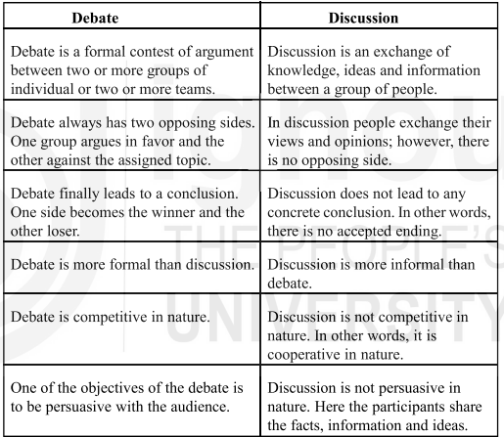

Slide 14
Conclusion
Both are valuable communication tools.
Debate sharpens arguments, while discussion builds understanding.

Slide 15
Thank You
😊

